Slide 1
Resource Summary
This drama-based resource looks at Harriet Tubman as an inspirational historical figure, focusing on the theme of identity. Your children will act out a scene about Harriet. Afterwards, they can participate in a Discussion, do a SATs-style Reading Comprehension or try out the Writing Opportunities – whatever suits your needs best.

Slide 2
Do the first two activities to start – and then pick from the others:
1. Who Was Harriet Tubman? (10mins) | Slide 3
Run through this if your class has never studied Harriet Tubman.
2. Script (20 – 50mins, depending on how you lead it) | Slides 4 – 6
A fully participatory way to do this would be:
Read it as a whole class (10mins)
Direct one group of children at the front, as a model (15mins)
Split into groups of five (or six including a director) and let each group rehearse on their own (15mins)
Everyone shares their performances (10mins)
If you’re short on time, you could do steps iii) and iv) in a later lesson.
Note: print the 2-page, A4 PDF of the script, if you wish to provide physical copies for your children.
3. Discussion (20mins) | Slide 7
Lead this after doing the script. Some of the questions could open up much longer debates!
4. SATs-style Reading Comprehension (20 – 30mins) | Slides 8 – 13
Either do this on the board (as a whole class / in groups, etc.) or print it for individuals; the latter will take longer.
5. Writing Opportunities (50mins) | Slide 14 – 15
Pick one as a class to plan together, or let children pick their own.

Slide 3
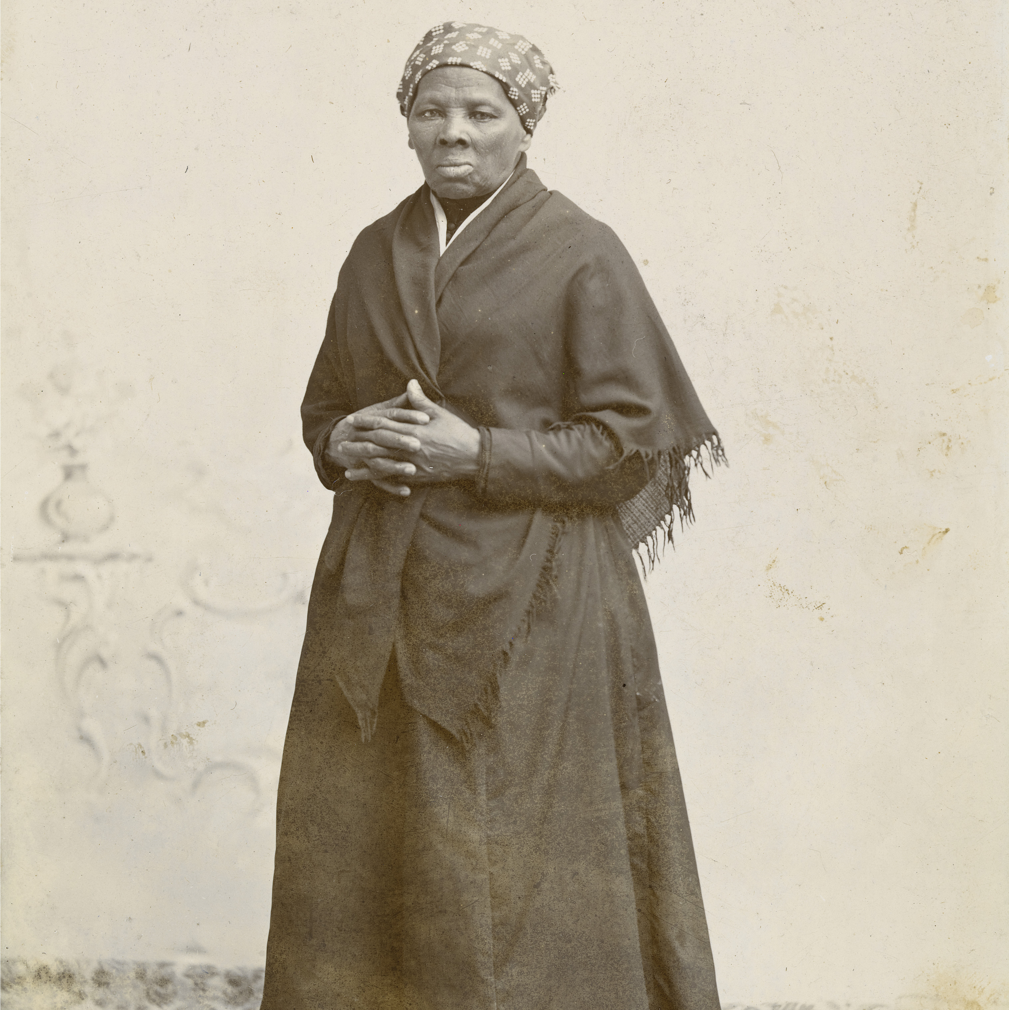
Harriet Tubman was born in 1822 in America. She was an abolitionist: someone who fought for slavery to be abolished.
She escaped enslavement herself before returning many times to free others, putting herself at risk.
She was called a ‘Conductor’ on the ‘Underground Railroad’ - not a real railway, but a network of safe passages from the south of America (where slavery was legal) to the north (where it was illegal).
Later in life, she worked as a soldier, spy and a nurse in the American civil war. She bought her own land and carried on fighting for causes she believed in, including women’s right to vote.

Slide 4
Characters
Harriet – Harriet Tubman
Mrs Pattison – Harriet’s owner (also plays Townsfolk 1)
Shopkeeper – runs the shop (also plays Townsfolk 2)
Fred – recently bought by Mrs Pattison (also plays Townsfolk 3)
Overseer – works for Mrs Pattison, overseeing the enslaved workers
A baby is crying in the cradle in the Pattison farm house. Harriet enters and rocks the cradle.
Harriet: Shhh shh baby, go to sleep.
Baby cries harder.
Harriet: Pleeease baby go to sleep! Your mama will hear you and…
Mrs Pattison enters
Mrs Pattison: What are you doing to my baby?!
Harriet: Sorry ma’am.
Mrs Pattison goes over and quiets the baby.
Mrs Pattison: Shh shh now, it’s alright, mama’s here. [The baby is quiet]. I have really tried with you Harriet, but you are a useless, lazy girl. I’m half minded to sell you. Make yourself useful, for once, and fetch me a bag of flour from town.
Harriet: Yes m’am. Sorry m’am.
Mrs Pattison: Be quick about it. Or you’ll really be in trouble.
Harriet walks along the hot, dusty road. She fans herself. She looks at the birds flying overhead.
Harriet: I wish I were a bird. I wish I could just spread my wings and fly away from here.
Tip: Print the 2-page, A4 PDF of this script, if you need physical copies.

Slide 5
Townsfolk 1: Fine day we’re having.
Townsfolk 2: It’s a hot one!
Townsfolk 3: I’m just heading into the store.
Harriet lets the townsfolk and Overseer enter the store before her, then she heads in.
Shopkeeper: What you want, girl?
Harriet: Flour for Mrs Pattison….
The Shopkeeper scowls at her
Harriet: …if it’s no bother.
Shopkeeper: Over there. No dawdling, I won’t have your kind loitering.
Harriet looks for flour when suddenly Fred bumps into her.
Fred: Please let me through!
Shopkeeper: He’s trying to escape!
Overseer: Stop that slave!
Fred: Harriet, don’t let him get me!
Harriet blocks the doorway.
Fred: Thank you!
Overseer: [to Harriet] Get out of my way!
The Overseer (mimes) picking up a heavy weight from a shelf.
Overseer: I said move, slave!
He throws the (imaginary) weight and hits Harriet in the head. She falls. Fred is gone.

Slide 6
It’s night. Harriet lays on the ground, passed out. She dreams that the Overseer, Shopkeeper and Fred are standing around her.
Overseer: If she wakes up, Mrs Pattison will sell her for sure.
Shopkeeper: Trouble-makers, the lot of them.
Fred: I won’t forget you, Harriet.
The Overseer, the Shopkeeper and Fred lie down, becoming other sleeping workers at the farm. Harriet wakes up. She feels her head and looks at her hand; blood.
Harriet: Fred..? [she checks those asleep around her.] He made it. He got away. To the North, to the promised land.
Harriet carefully gets up. She ties a scarf around her head to stop the bleeding.
Harriet: If she sells me, where will I go? Where will I end up? [pause] What did the Overseer call me? A slave. [she writes it out in the dirt]. My mama said that our people, our ancestors, were called queen, elder, sister… before they were stolen.
Harriet looks at the word and rubs it out with her foot. She bends and writes HARRIET in its place.
Harriet: Mama said I’m good and clever and brave. She told me no one can own a person’s spirit. That means it can’t be bought or sold either. I can’t be bought or sold. [pause] There’s freedom in the north. There are others like me up there. My people. If I stay, who will I be?
Harriet looks around at the farm.
Harriet: Go free or die. Those are the only options as far as I can see.
A bird calls in the sky. Harriet smiles up at it. She takes a long, deep breath.
Harriet: I know what I have to do. Spread my wings. Fly away north. Escape to freedom.
Harriet finds the North star in the sky and takes her first few steps…

Slide 7
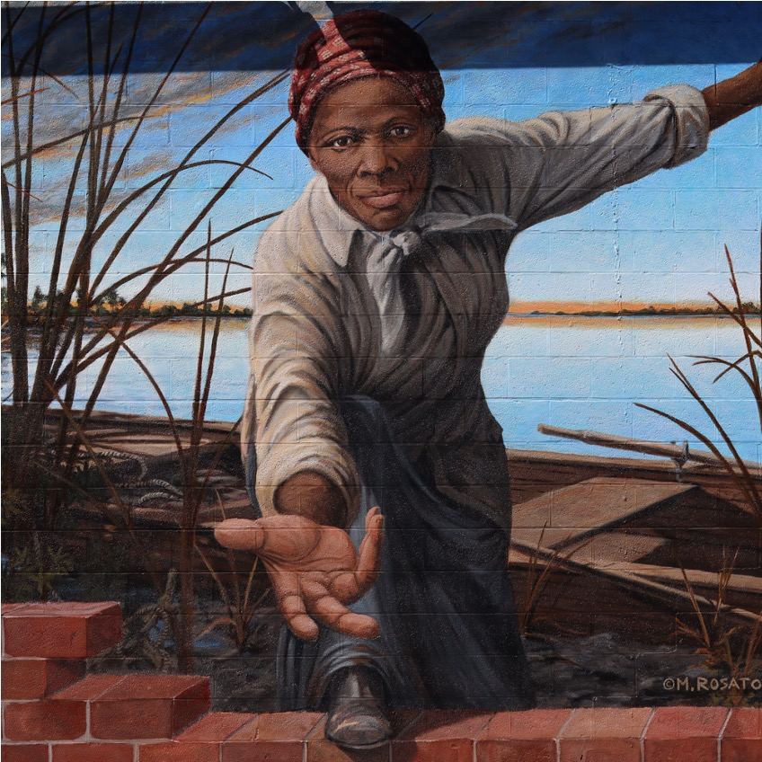
Is Harriet free to leave Mrs Pattison’s service? Does she get paid to work?
What do you think of the idea that a human could ‘sell’ another human? Do you remember what Harriet’s mother says about it?
When Harriet says ‘Who will I be?’, what does she mean? What are the options she has?
What are the words with which Harriet replaces the word ‘slave’ in the dust? Why do you think it was important for her to remember her heritage?
What were all the things that Harriet became later in life? What do you think of her achievements?
Der Hezer

Slide 8
Do note that the script has been slightly changed for the sake of this Reading Comprehension.

Slide 9
Harriet lets the townsfolk and Overseer enter the store before her, and then she heads in.
Shopkeeper: What you want, girl?
Harriet: Flour for Mrs Pattison….
He scowls at her.
Harriet: …if it’s no bother.
Shopkeeper: Over there. No dawdling. I won’t have your kind loitering.
Harriet looks for flour when suddenly Fred bumps into her.
1
Which word means ‘people from the town’?
_________________________
1 mark
2
The shopkeeper did not like Harriet. Find and copy two phrases that show this.
____________________________________________ and ______________________________________________
2 marks
3
Harriet looks for flour when suddenly Fred bumps into her.
Choose the best words to match the sentence above. Circle the correct word in each line.
Harriet for flo for flour
when
Fred into her.
asks
prepares
searches
murmurs
unexpectedly
forcefully
finally
carelessly
throws
collides
dives
pushes
3 marks

Slide 10
Fred: Please let me through!
Shopkeeper: He’s trying to escape!
Overseer: Stop that slave!
Fred: Harriet, don’t let him get me!
Harriet blocks the doorway.
Fred: Thank you!
Overseer: [to Harriet] Get out of my way!
The overseer picks up a heavy weight from a shelf.
Overseer: Move, slave!
Fred is gone. The Overseer throws the weight and hits Harriet in the head. She falls to the ground.
4
Tick true or false in the following table to show what happens in the text above.
 | True | False
Fred tries to escape.
Harriet tries to help the Overseer.
The Overseer successfully stops Fred from leaving the shop.
Fred accidentally hits Harriet on the head with the weight.
4 marks

Slide 11
It’s night. Harriet lays on the ground passed out. She is dreaming…
Overseer: If she wakes up, Mrs Pattison will sell her for sure.
Shopkeeper: Trouble-makers, the lot of them.
Fred: I won’t forget you, Harriet.
Harriet wakes up. She feels her head and looks at her hand; blood.
Harriet: Fred...?
Harriet checks those asleep around her. Fred is not there.
Harriet: He made it. He got away.
Harriet carefully gets up. She ties a scarf around her head to stop the bleeding. She hears birds calling overhead and looks up to try to spot them.
5
Which word is closest in meaning to ‘passed out’?
sleeping injured unconscious resting
1 mark
6
Why do you think that Fred says ‘I won’t forget you’ to Harriet (in her dream)? _________________________________________________________________________________
1 mark
7
What does it tell us about Harriet’s character that the first thing she does is to check whether Fred has escaped?
_________________________________________________________________________________
1 mark

Slide 12
Harriet: What did the Overseer call me? A slave. [she writes it out in the dirt] My mama said that our people, our ancestors, were called queen, elder, sister… before they were stolen.
Harriet looks at the word and rubs it out with her foot. She writes HARRIET in its place.
Harriet: Mama said I’m good and clever and brave. She told me no one can own a person’s spirit. That means it can’t be bought or sold either. I can’t be bought or sold. [pause] There’s freedom in the north. There are others like me up there. My people. If I stay, who will I be?
Harriet looks around at the farm.
Harriet: Go free or die. Those are the only options as far as I can see.
A bird calls in the sky. Harriet smiles up at it. She takes a long, deep breath.
Harriet: I know what I have to do. Spread my wings. Fly away north. Escape to freedom.
8
Find and copy a group of words that shows that Harriet’s ancestors were kidnapped against their will.
________________________________________________________________________________________
1 mark
9
Why do you think Harriet smiles when she looks up and sees the bird?
________________________________________________________________________________________
1 mark
10
Find and copy one example of a metaphor.
________________________________________________________________________________________
1 mark

Slide 13
Townsfolk
’The Shopkeeper scowls at her’ and ‘I won’t have your kind loitering.’ (1 mark each)
3. - searches
- unexpectedly
- collides (1 mark each)
4. True, false, false, false (1 mark each)
5. Concussed
Because Harriet helped him.
Award 1 mark for anything that implies Harriet is selfless / puts others first.
‘before they were stolen’
Award 1 mark for anything that implies she is thinking of freedom.
‘Spread my wings’ or ‘Fly away north.’
Scores are out of a total of 16.

Slide 14
Diary Entry | “The Day I Decided”
As Harriet Tubman, write a diary entry for your traumatic day. Events you could include are:
Not being able to comfort Mrs Paterson’s baby and being sent to the store
Blocking the Overseers in order to allow Fred to escape
The Overseer hitting you on the head with the weight
Waking up form being unconscious, and resolving to escape
Remember to include how you felt, not just what you did.
Continue The Story | “Escape From The Farm”
Imagine Harriet escapes the same night. She would probably have been sleeping in a room with the other enslaved workers. The first time, she escaped alone. Did she wait until it was dark? How must she have felt, waiting? Was the room locked? What noises would she have heard as she escaped?
Once she was out, how did she find her way? Many escapees followed the North Star in the night sky to direct them North – to freedom. You could finish your story with finding refuge in a ‘safe house’ (these were sympathetic people who helped and sheltered enslaved workers).
Continue on next page

Slide 15
Blackout Poem | “Harriet Tubman”
Write a blackout poem to celebrate Harriet Tubman’s life and bravery.
Choose a page of text (this is often from a newspaper but can be any text) and, using a black felt tip, black out lots of the words. The words you choose to leave will form your poem.

