Slide 2
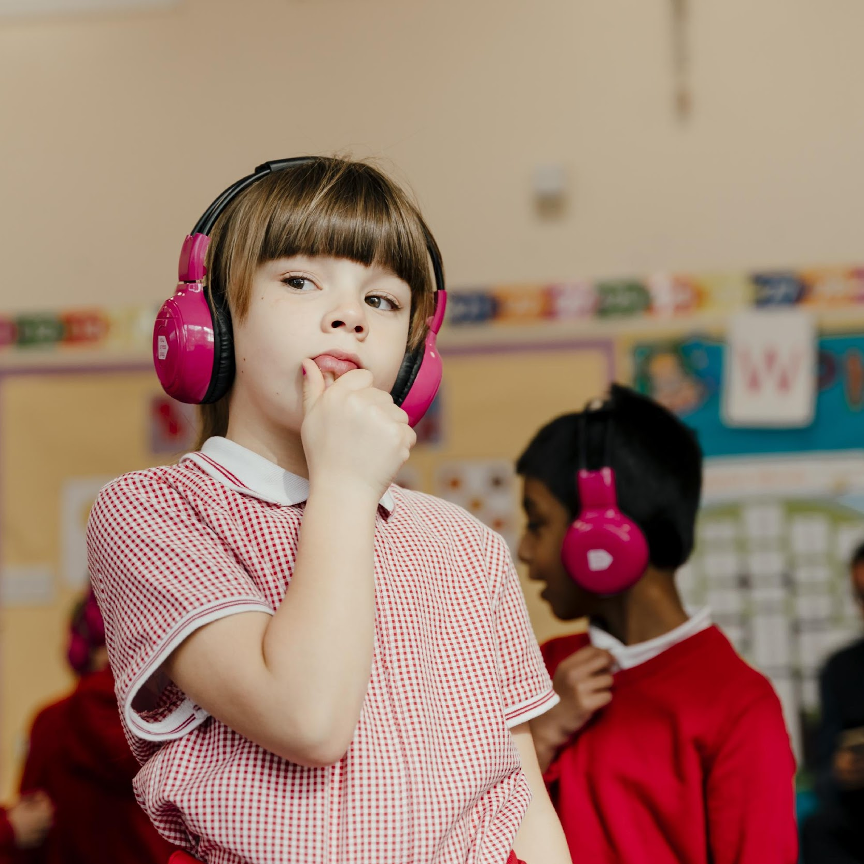
What sounds do we have in school?

Slide 3
What sounds do we have in school?
Schools can be noisy places! Sound can be:
Positive (laughing, singing, praise, linked to learning)
Distracting (shouting, off-task conversation, outside world e.g. drilling)
Informative (school bells, whistles, tannoys)
By using audio consciously, we can reduce the negative and harness multiple benefits.

Slide 4
What types of audio can be used?
Schools often have plenty of audio equipment but it is typically under-utilised.
You can listen to audio via:
Speakers (hall, classroom, laptops, tablets)
Headphones
You can record audio via:
Laptops
Tablets
Microphones (though they’re not necessary!)

Slide 5
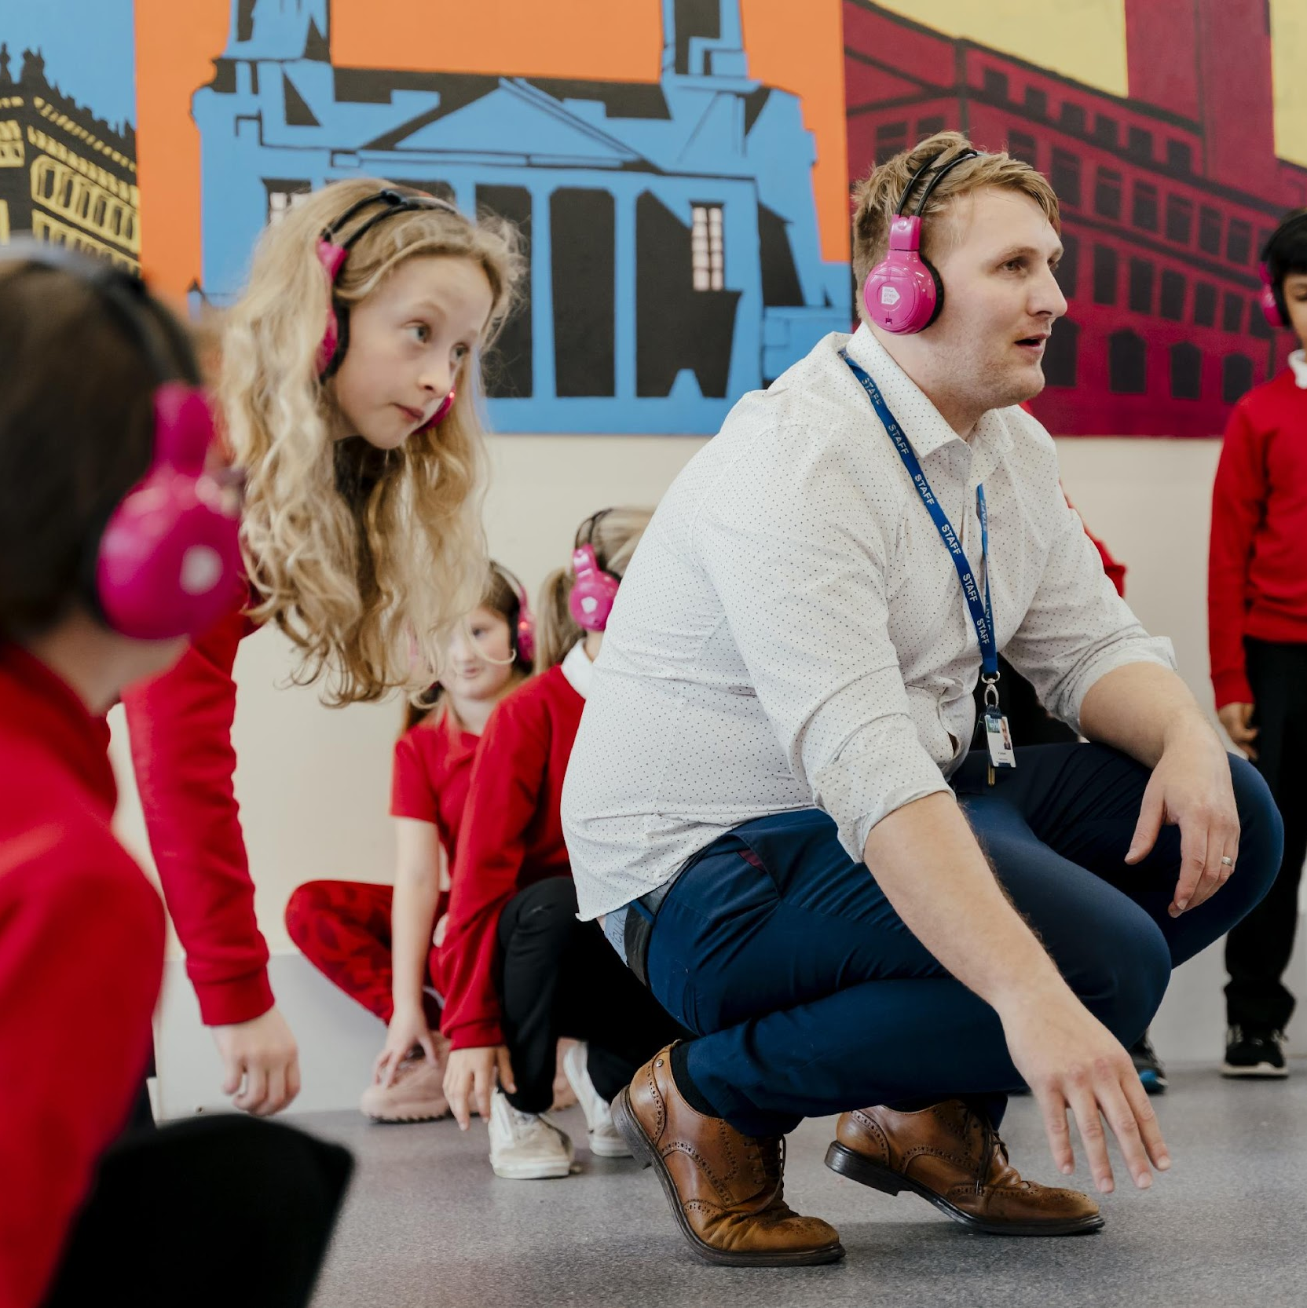
Why use audio in schools?

Slide 6
Why use audio in the classroom?
Audio can:
Focus listening
Inspire the imagination
Raise engagement
Shift the mood
Improve retention
Improve talking (oracy), e.g. for writing opportunities (see Voice21)

Slide 7
How can you use audio in the classroom?

Slide 8
How can you use audio in the classroom?
Set atmosphere & tone: have music playing as children enter. This works well with the youngest children (combine with set movement) as well as the oldest (who will start requesting songs, which you can ignore or heed!).
Sound effects for stories: effects, ambiences and music all set the scene and bring stories to life. Stream these directly (e.g. YouTube), or download in-advance (from royalty-free websites, e.g. Freesound.org).
Record stories: Children can record original or existing stories. Use Adobe Creative Cloud, Audacity (on Windows), GarageBand (comes with Apple products) or in-built recording software on phones/laptops. Combine with sound effects or even specially composed musical underscore (this can be very simple).
Create podcasts: Children can create podcasts on current affairs, topics they’re studying or school news items. They can even broadcast using tools such as Anderton Tiger’s School Radio systems.
Live commentate: hook up a microphone to a speaker, and have children live-commentate / MC an event.
Digital escape room: In OneNote learners correctly identify sounds to unlock the next room
Scavenger hunt: Children can use devices (e.g. tablets) to hunt for QR codes around the school, with the next clue then given as audio.
Silent disco: if you have wireless headphones
Audio tour for parents/carers: record audio for parents to access/download on their device and take around the school.

Slide 9
How can audio assist me as a teacher?
Audio feedback can be left for children on digital work. This makes it more personal, relevant and accessible – plus it can be played back again and again. It can also reduce your workload, proving quicker than leaving written feedback. Tools such as Mote or OneNote are great at facilitating this.
Log learning: platforms such as ReallySchool, Showbie and Seesaw can capture audio of children’s speaking & listening work, presentations, and so on.
Provide extra scaffolding: audio can help support learners, particularly those with a visual impairment. Teachers pre-record prompts on digital resources made in PowerPoint, Book Creator, Canva, interactive PDFs, etc.

Slide 10
Case study: Prince of Wales School, Dorset
This primary school plays upbeat music every morning as the children come through the school gates. They have found several benefits, including:
Positive messages promoted (by the lyrics of the songs)
A lift in mood as soon as children arrive
Sets a dynamic tone for teaching and learning
Parent feedback has noted all of the above differences in their children, when the music is played (and they appreciate it themselves!)

Slide 11
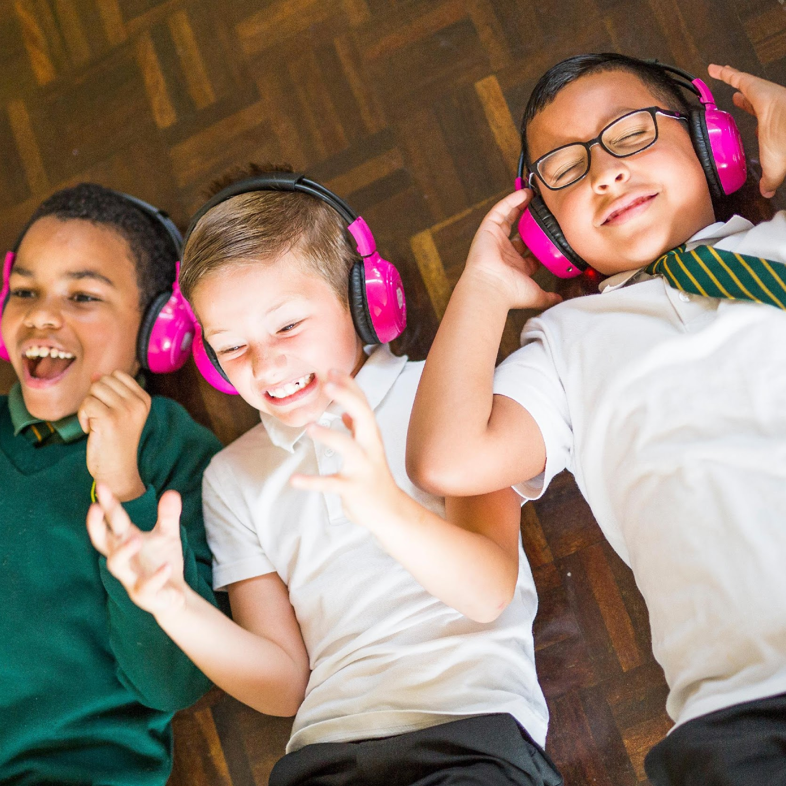
What is immersive audio and how can it be used?

Slide 12
How does an ‘immersive audio experience’ work?
In an immersive audio experience, children are placed in the world of their topic and go on an adventure.
They wear wireless headphones which connect wirelessly to a transmitter.
The transmitter is plugged into the teacher’s device.
Any audio played on the teacher device plays on the headphones.

Slide 13
How do immersive audio experiences help teaching and learning?
Short-term outcomes:
Increases engagement
Strengthens accessibility, particularly for children who enjoy moving.
Promotes listening
Improves behaviour by removing outside distraction
Long-term outcomes:
Promotes empathy by stepping into someone else’s shoes
Increases cultural capital by transporting children somewhere new, like a school trip
Better retention and understanding as the topic becomes relevant and meaningful
Inspired discussion / oracy and quality writing, after the experience

Slide 14
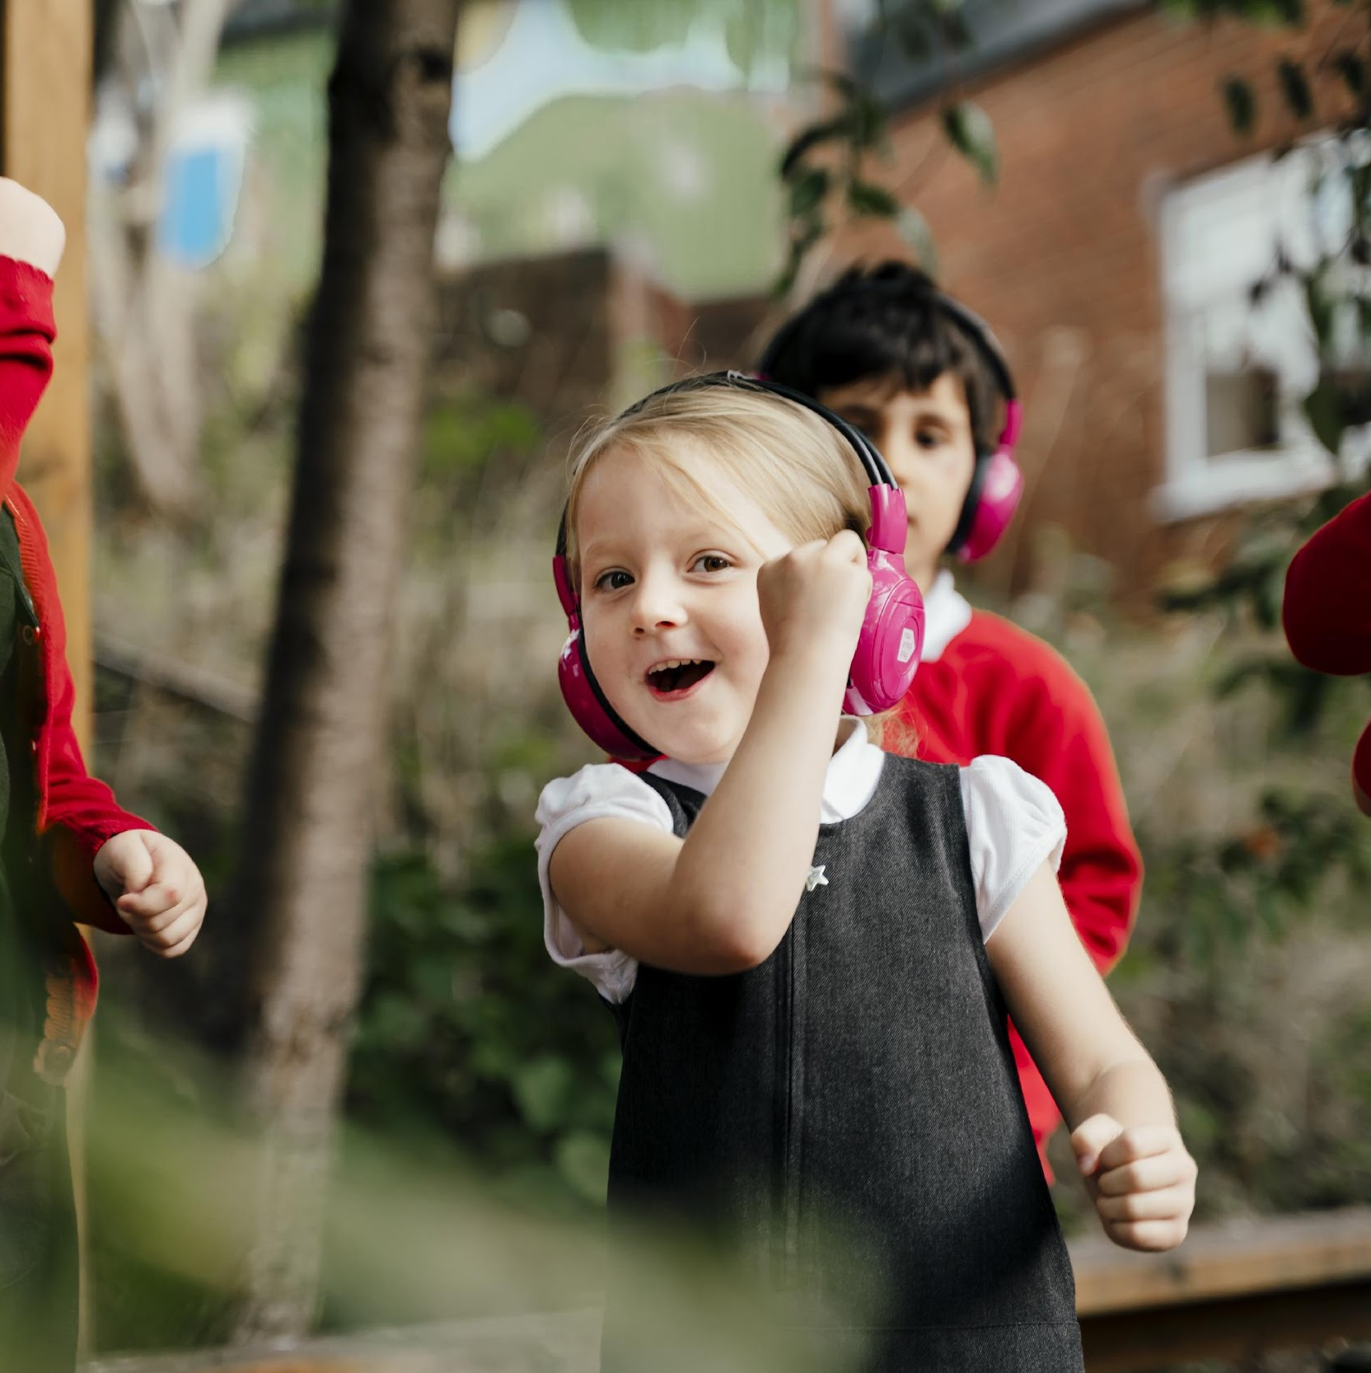
Get the gear – and an idea!

Slide 15
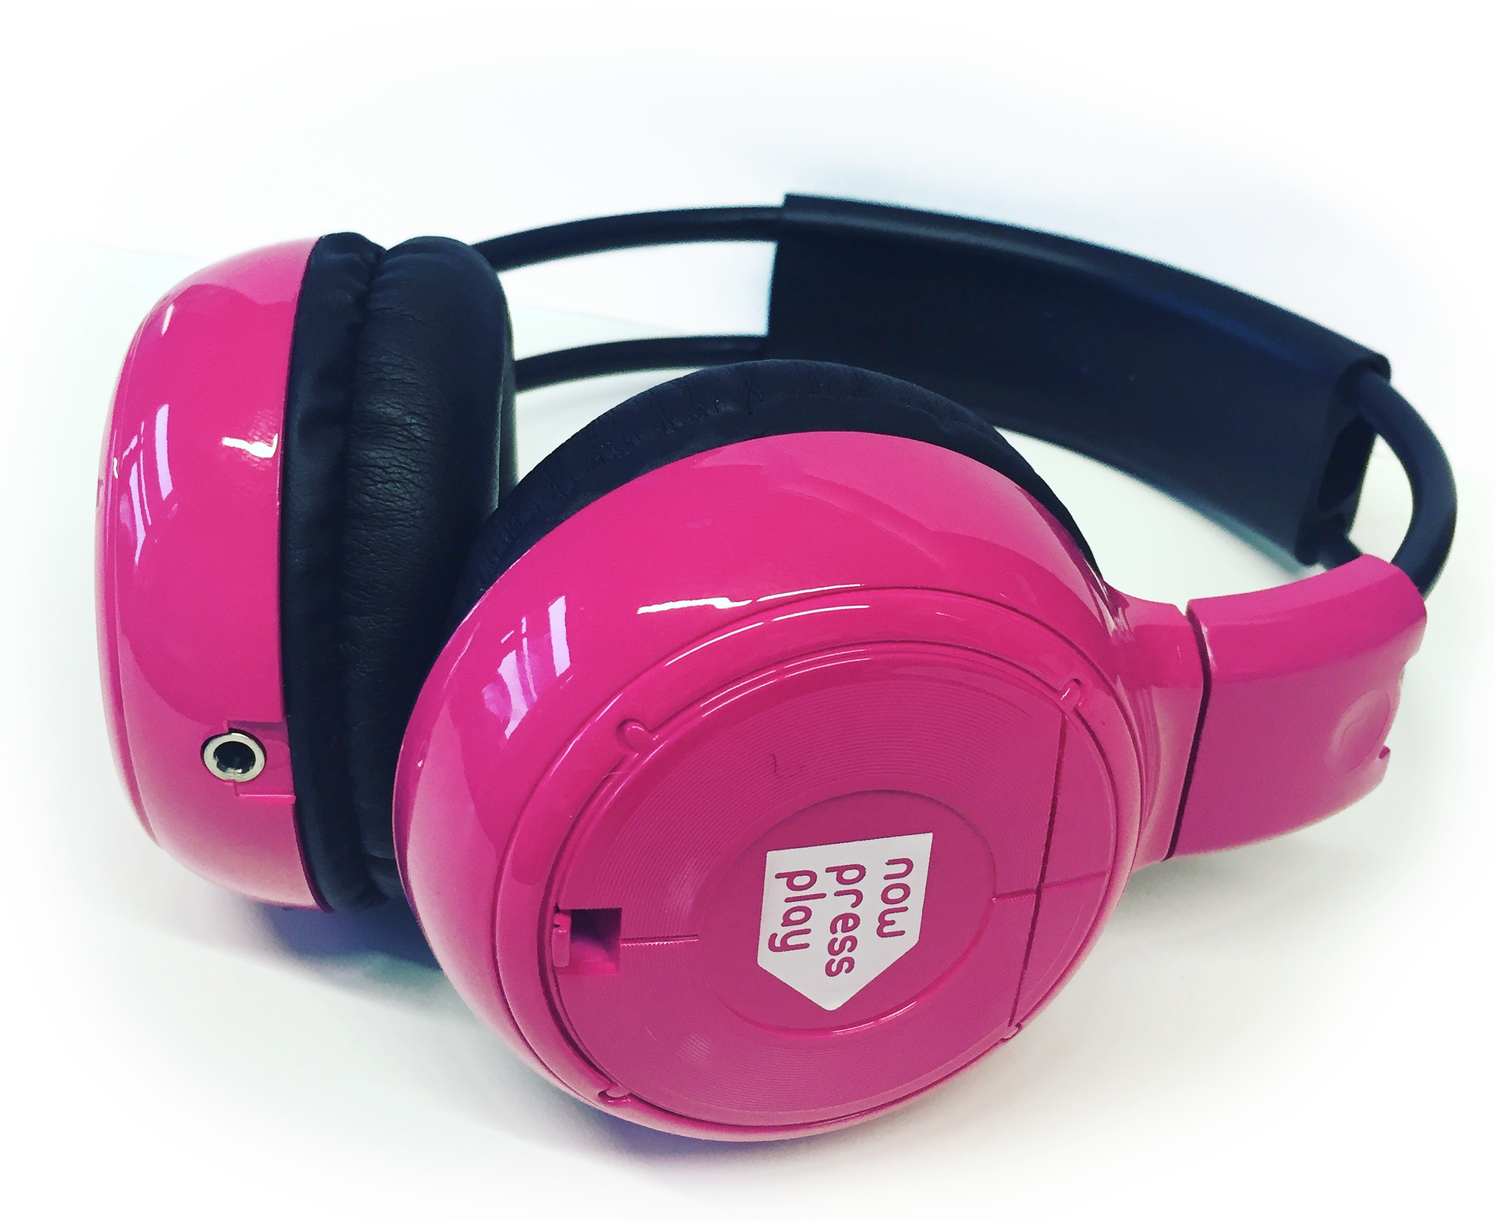
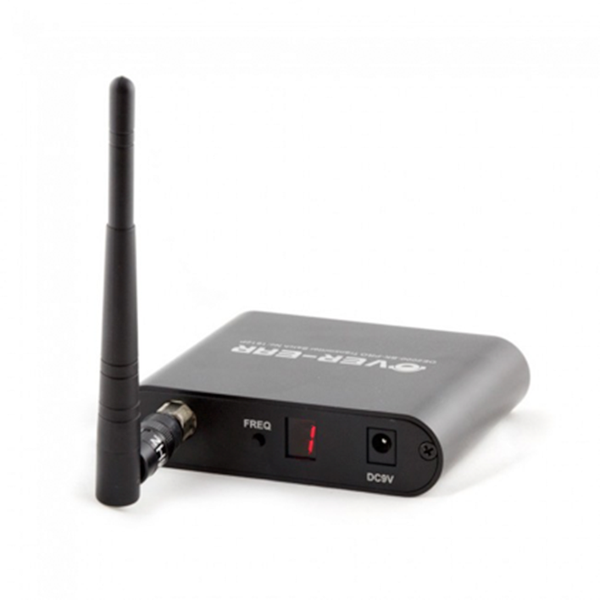
How can you access immersive audio?
You could purchase the equipment yourself
You could explore using the award-winning now>press>play equipment and associated resources to give better value for money.

Slide 16
What can you do with now>press>play?
now>press>play comes with 90+ Experiences and 400 Follow-On Resources
Each Experience aligns with primary curriculum topics, across EYFS, KS1 and KS2.
Covers subjects including History, Geography, Science, PSHE, Literacy and Maths.
Saves teacher time, with lessons ‘on a plate’.
There are editable, follow-on resources to tailor to your class (including discussion, reading comprehension, grammar and punctuation, and writing opportunities). These ready-made activities reduce teacher workload.

Slide 17
What can you do with the equipment?
You can play any audio from your device via the transmitter:
Existing content (audiobooks, radio, news, podcasts, YouTube)
Sound to help learners focus (e.g. music / white noise); those who don’t need it simply remove the headphones
Music or sound (e.g. soundscapes for stories; use in music lessons)
Silent Discos (e.g. for end-of-week reward or the staff party!)
You can also connect a microphone to the transmitter, and deliver:
Lesson instructions
School radio – plug in the transmitter and have children ‘broadcast’ to classmates. ‘Radio’ apps like Speaker can help create a radio feel (with effects, stings, transitions, etc.)
Games (e.g. scavenger hunt)

Slide 18
Case study: Shireland Technology Primary School, Smethwick
This West Midlands school has been using now>press>play’s equipment as a tool to facilitate a golden time silent disco
To improve attendance, children who achieve 100% attendance earn a letter: D, I, S, C or O.
Once they have achieved 5 weeks of 100% attendance they make the word ‘DISCO’ and this then becomes their ticket to the golden time silent disco
Attendance has significantly improved as a direct result of this activity

Slide 19
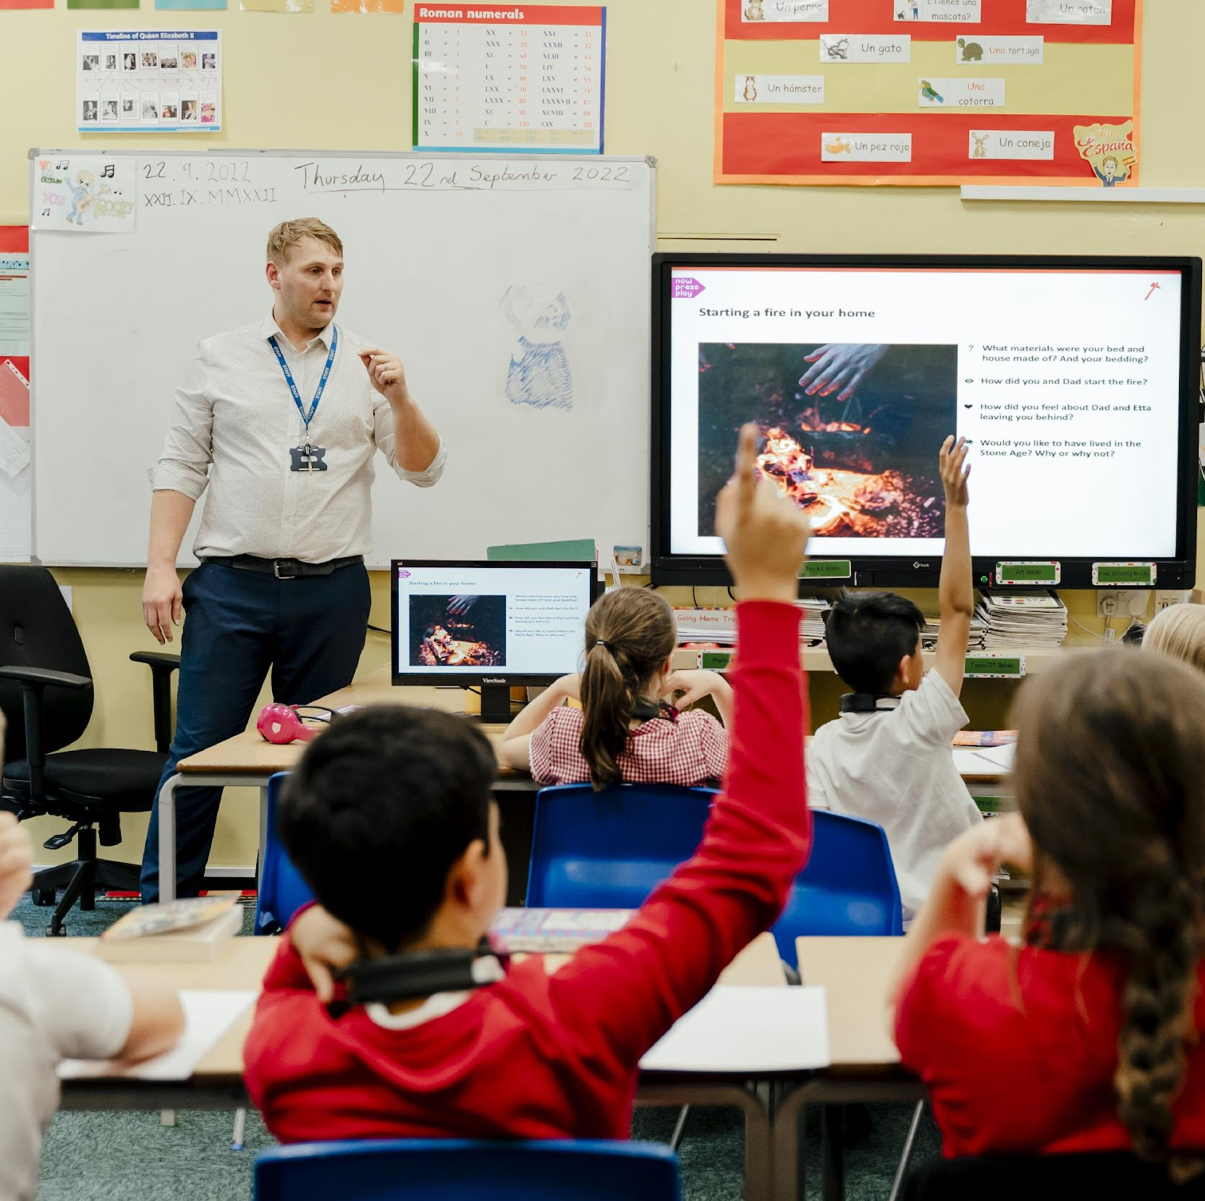
School leadership: How can you make IT work?

Slide 20
Implementation: It’s importance and starting with ‘Why’
The following slides share approaches to implementing technology in your school
New technology in any setting should address a demonstrated need or requirement where it serves:
A way to support teaching
A way to enhance learning
A way to reduce workload

Slide 21
Implementation of technology: And how to do it
There’s no point in buying tech for the sake of it so identify what is needed and what you want it to achieve to help.
Find solutions that match your need. Recognise that cheapest isn’t always best, consider workload.
Build staff training of confidence and competence. Without this the solution will not fulfil its intended purpose.
Spend time using the solution in purposeful and regular ways in the curriculum, not for the sake of it but where it helps.
Teething problems always occur. Look at where problems exist, learn from them, tweak & improve how the solution is used.
Find the best solution
Refine and improve
Embed into curriculum
Identify need
Staff training
Re-subscribe or find new solution?

Slide 22
Change management
The next slide shares eight principles/areas you should spend time on and consider and the implications of what can happen should you not consider them in your implementation of new technology.
Consider each in turn and how you can make them work to support your implementation of your new technology.

Slide 23
Change management / Implementation of new technologies
Vision
Community
Team
Sustainable
Environment
CPD
Measurement
Learning
=
Ongoing success
Vision
Community
Team
Sustainable
Environment
CPD
Measurement
Missing
=
Failure
Vision
Community
Team
Sustainable
Environment
CPD
Missing
Learning
=
No success
Vision
Community
Team
Sustainable
Environment
Missing
Measurement
Learning
=
Anxiety
Vision
Community
Team
Sustainable
Missing
CPD
Measurement
Learning
=
Frustration
Vision
Community
Team
Missing
Environment
CPD
Measurement
Learning
=
Unsustainable
Vision
Community
Missing
Sustainable
Environment
CPD
Measurement
Learning
=
Confusion
Vision
Missing
Team
Sustainable
Environment
CPD
Measurement
Learning
=
Resistance
Missing
Community
Team
Sustainable
Environment
CPD
Measurement
Learning
=
False starts
Created by Mark Anderson @ICTEvangelist

Slide 24
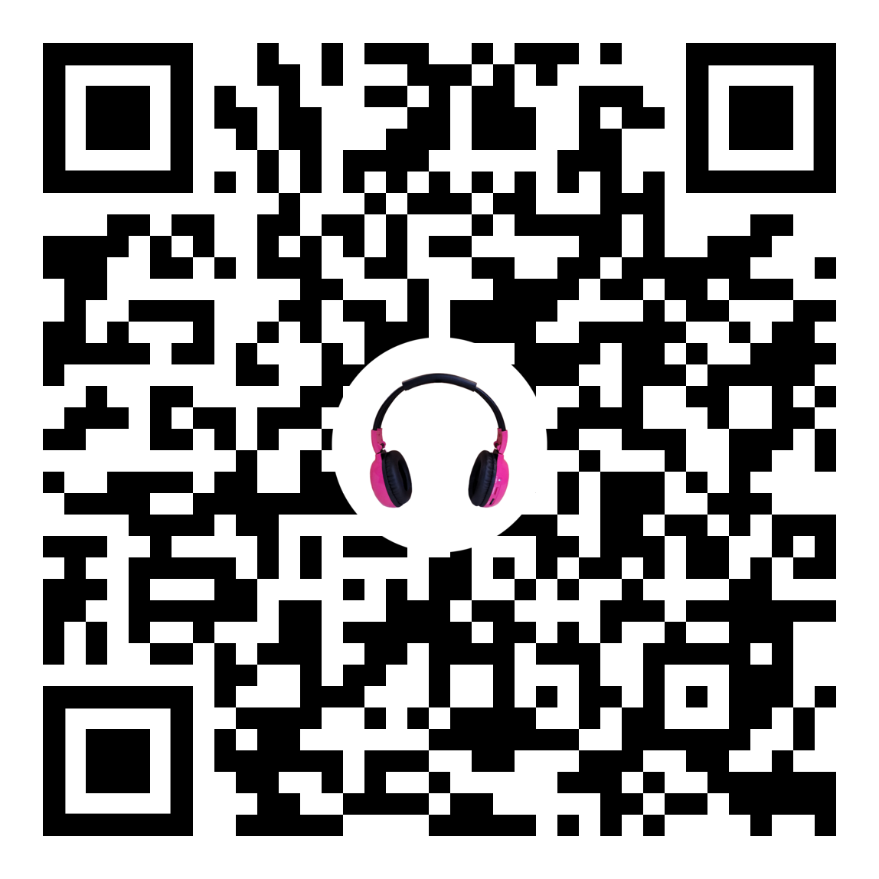
This resource was created in conjunction between Mark Anderson @ICTEvangelist and now>press>play.
Want help with your digital strategy, get in touch with Mark and his team via mark@ictevangelist.com
Book your 2-week free trial of now>press>play

